Slide 1
Chapter 12 The Future of the Winter Sport Tourism Industry
Simon Hudson

Slide 2
Topic Covered
The future for the ski industry
Ten consumer trends influencing winter sport tourism

Slide 3
Spotlight Tina Maze places Slovenia in the limelight
family facilities, novelty, affordable skiing, good value après ski…
winter amenities include a snow park, cross country trails, ice climbing, night skiing, sledding, snowshoeing, ski touring, and kids’ activities…

Slide 4
The future for the ski industry
North America: maturity, characterized by increased consolidation and diversification
Improve on every level to create better conditions for disabled travelers
The LGBT tourism (lesbian, gay, bisexual and transgender) market

Slide 5
Comparing 1994 to 2014 for the U.S. ski industry
Source: Adapted from Snowsports
Industries America, 2014b, p. 5

Slide 6
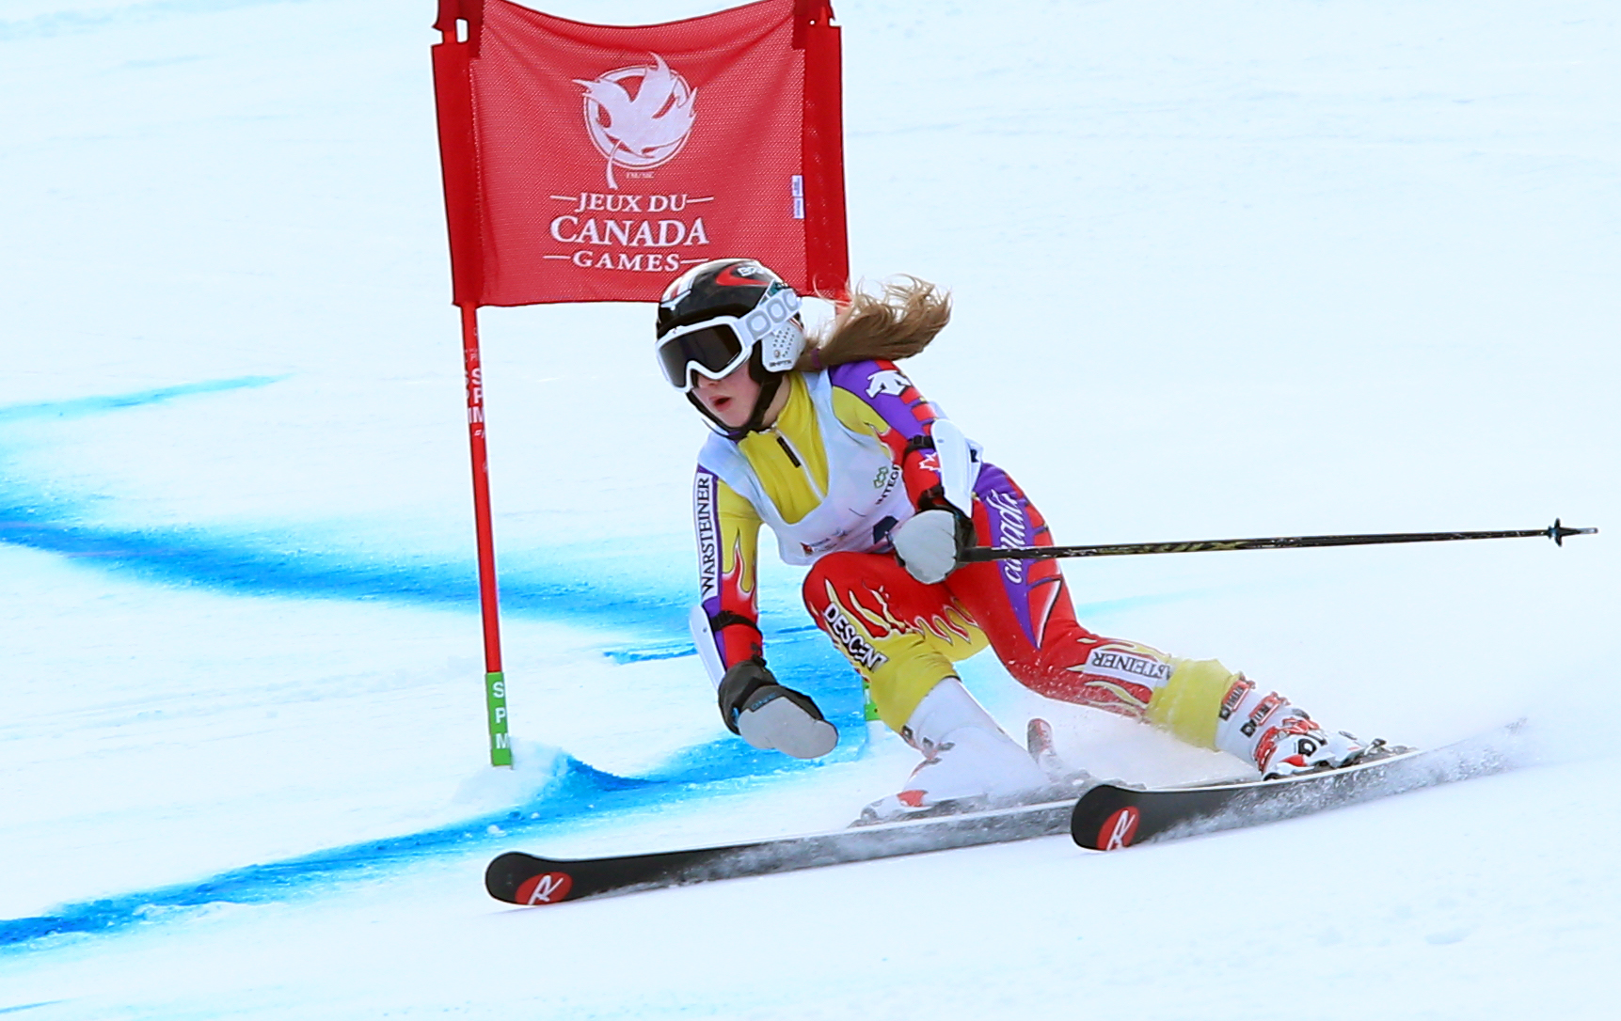
Profile From fear to fearlessness: Adaptive skiing
Encouraging disabled kids and adults to get into winter sports.
Example of Mel Pemble
Programs for locals and pro-rated lessons for visitors

Slide 7
Ten consumer trends influencing winter sport tourism
Learning and enrichment
Ethical consumption
Health-consciousness
Customization
Convenience and speed
Spiritual enlightenment
Service quality
Engagement and connectivity
The blurring of business and leisure travel
Experiences

Slide 8
The Top International Vacation Destinations for Europeans
Karaian & Yanofsky, 2014: Courtesy of Quartz.com

Slide 9
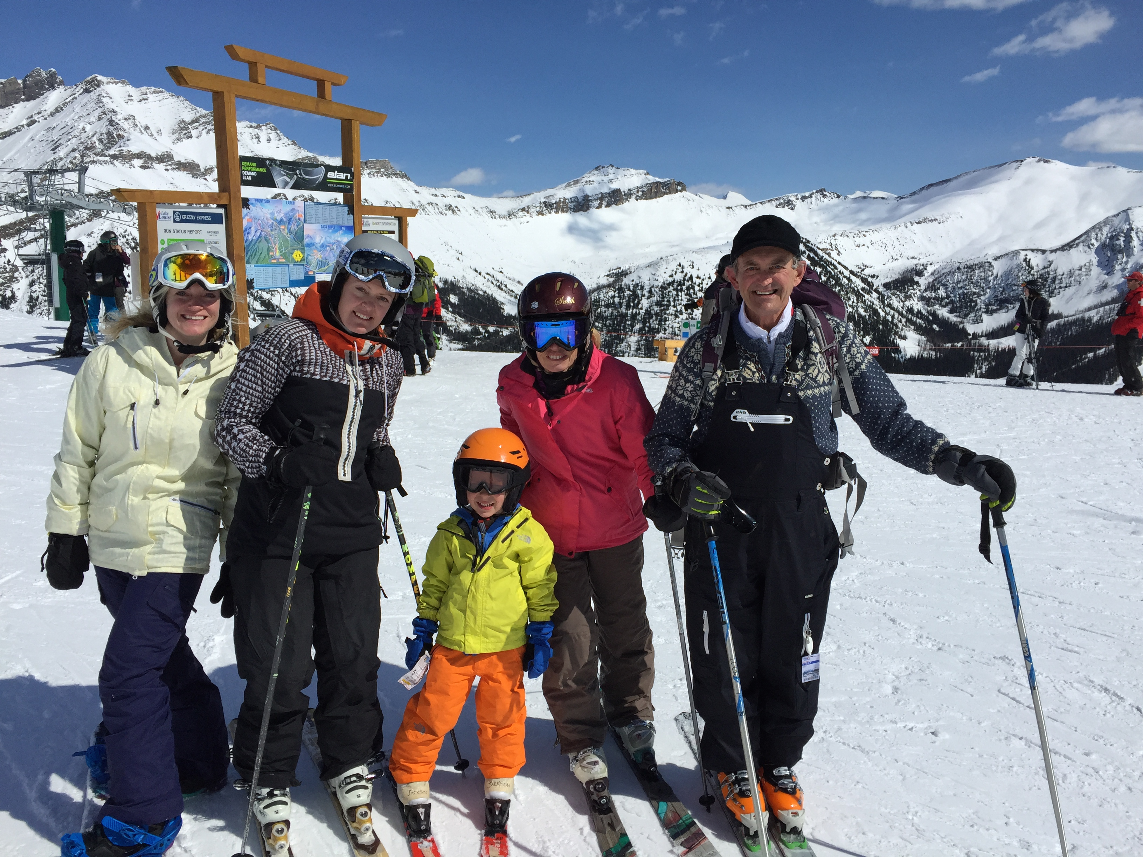
Case study The Locke ladies
Robin and Kimberley
Keep an eye on constantly morphing trends in the winter sports industry
Offer myriad activities
Sophisticated indoor product
Other initiatives

